Slide 1
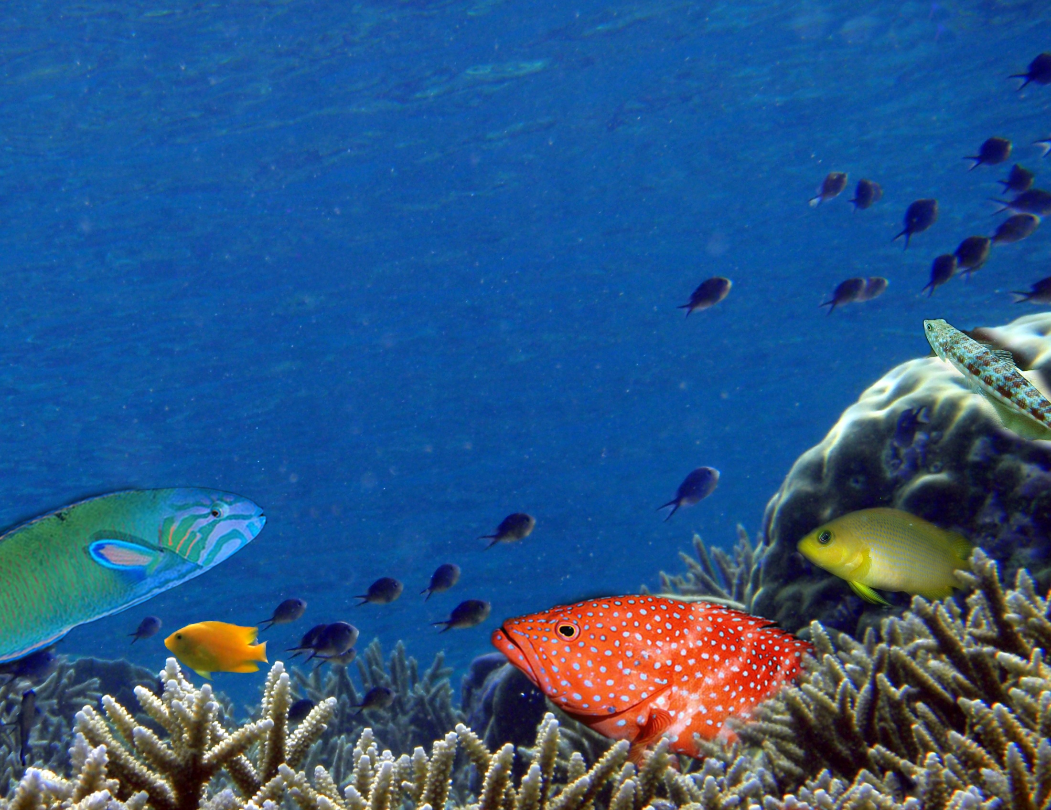
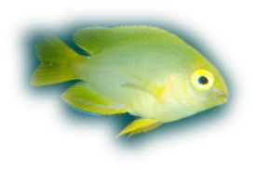


Learn and live: predator experience determines prey behaviour and survival
Mark McCormick
Oona Lönnstedt
Notes:
The study highlights the critical importance of experience with a predator in influencing survival in the field at settlement, and the interactive role that motivation to feed has in modifying behaviour and risk.

Slide 2
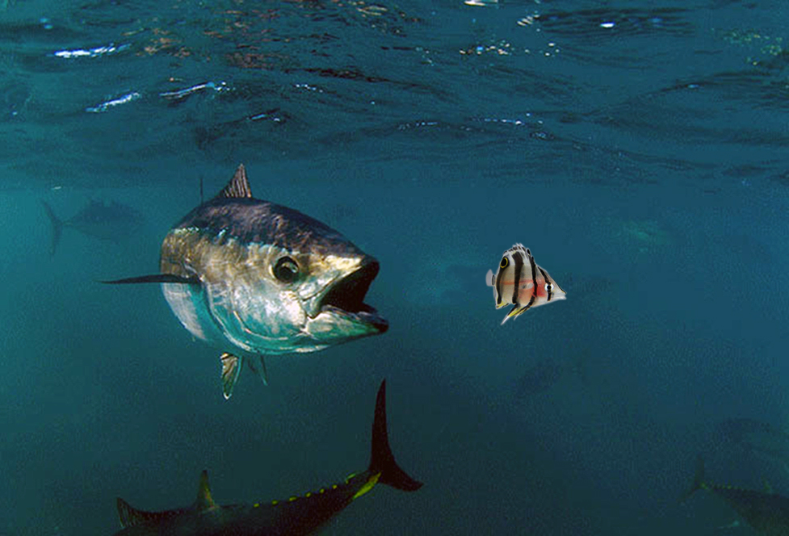
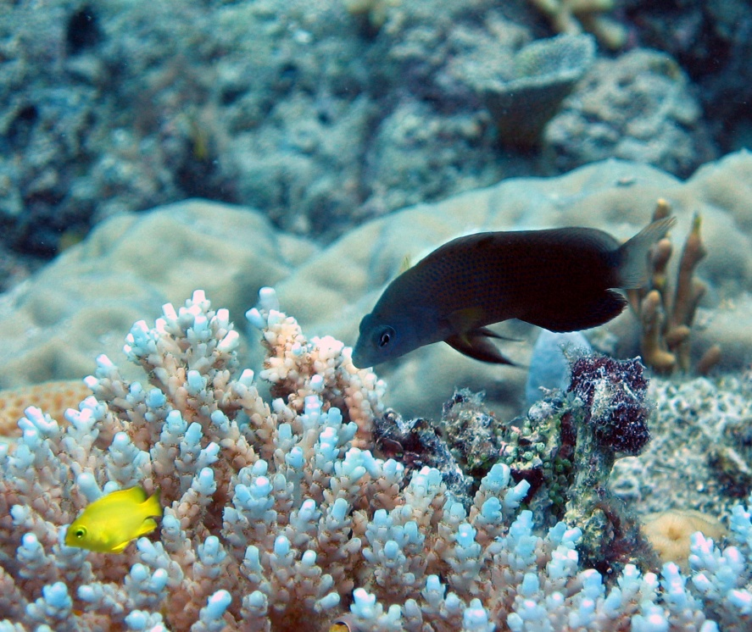
Threat of predation
Notes:
Many organisms live under the constant threat of predation, but for most of these, the magnitude of threats changes through time. Organisms are most vulnerable when they are small or young, or when they undergo ontogenetic shifts in habitat and encounter a new suite of predators. One such transition period which is the focus of the present study, is settlement.
The lack of familiarity with local predators greatly hinders the assessment of risk. Organisms should develop mechanisms that promote the rapid and efficient identification of novel predators to enhance risk assessment and promote survival. Understanding how organisms learn and modify their behaviour in relation to predators is fundamental to the dynamics of predator-prey interactions.

Slide 3
Onboard
Learnt
Notes:
Waiting on the reef for our little fishes are a myriad of fishes that would love to eat a small fish as it comes into the reef.
While many of these are quite small, often only a handspan in length, they can consume vast numbers of the baby fishes.
So, when little fish arrive, how do they manage to survive the many hungry mouths on the reef?
They need information on who to avoid. We’ve been looking at how they gain this information.
Their first source of information, is what could be called ‘onboard’ information about who predators are – they may have an innate (or genetically programmed) capacity to avoid certain dangerous fish species;
Alternatively, they could have a mechanism of learning who predators are....

Slide 4
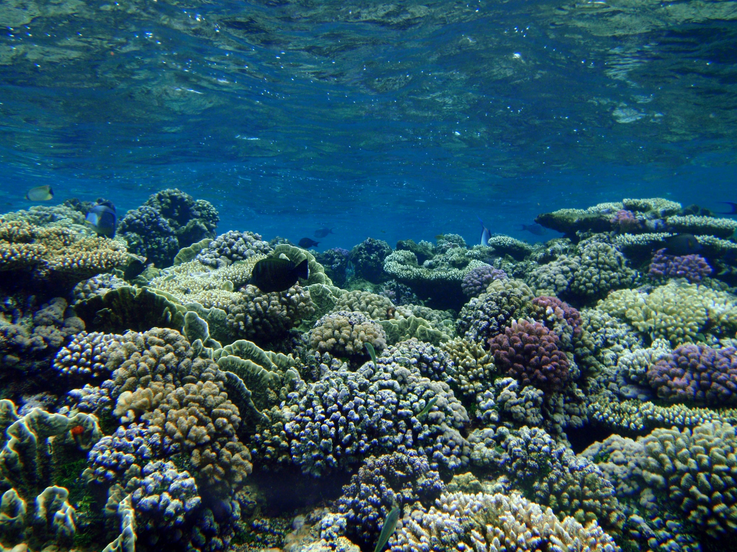
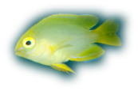
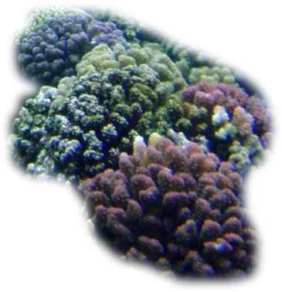
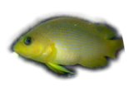
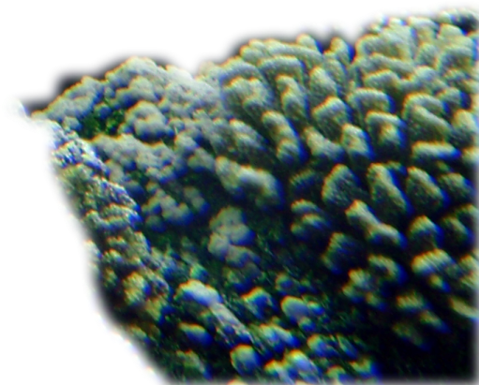
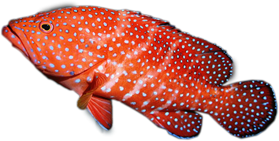
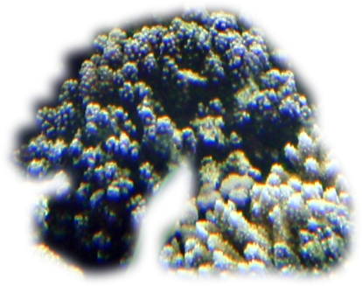
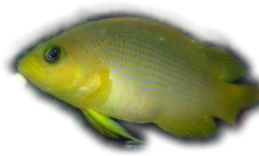
Notes:
When a new fish moves from the plankton and comes down to the reef to find a settlement site, she doesn’t know which types of predators are waiting for her.
Most reef fishes are strongly site attached, and many of these predators live within a 10 x 10m area for most of their lives. This makes the identity of predators very unpredictable among patches of habitat.
This suggests that onboard information is not going to tell the little fish all it needs to survive. It must have a mechanism whereby it can rapidly and efficiently learn about the predators that live in their little patch of reef.

Slide 5
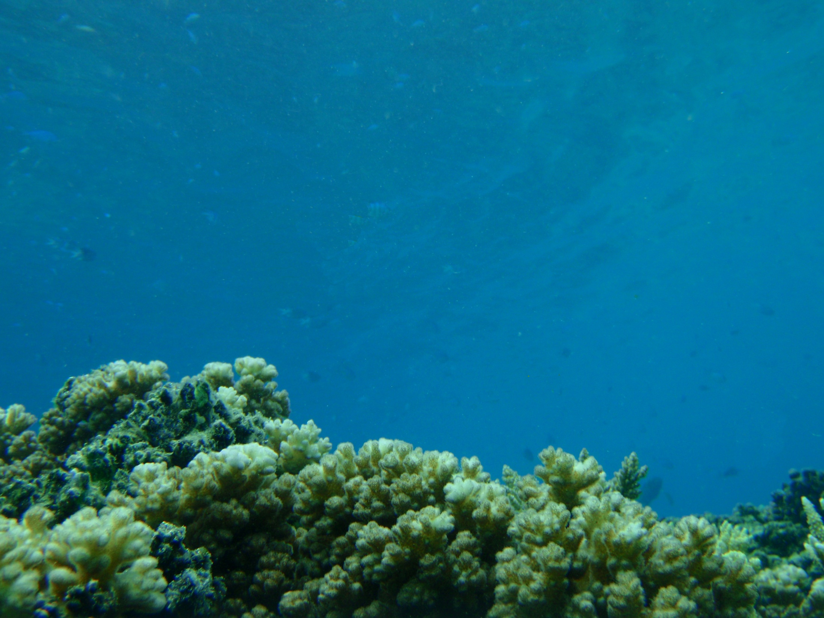

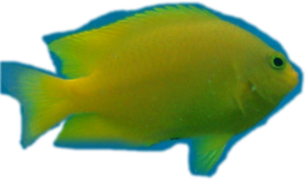
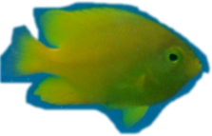
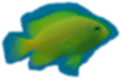
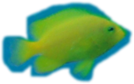


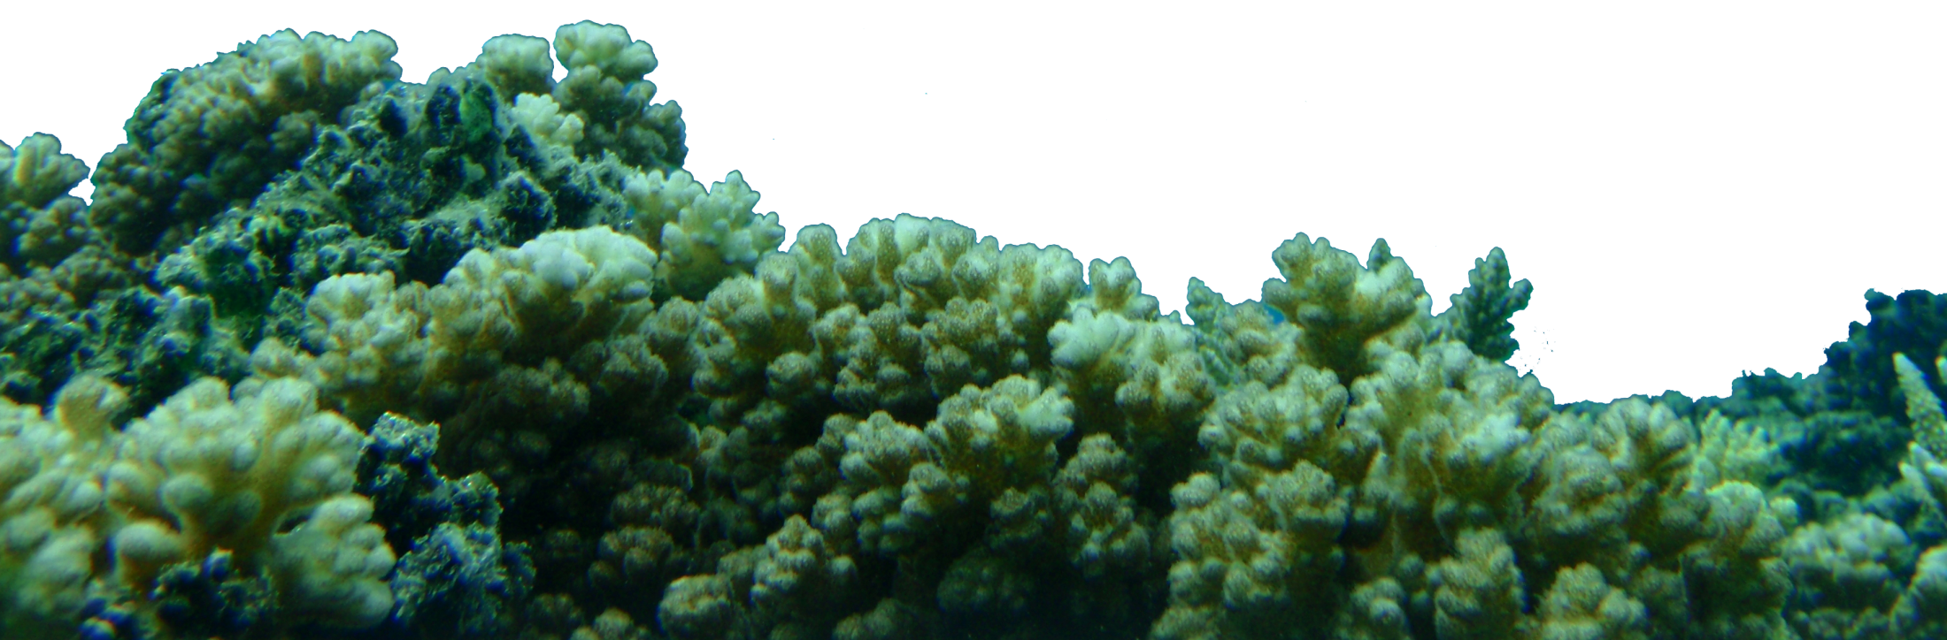

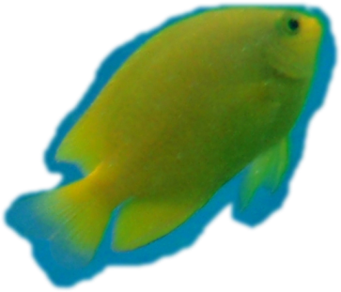

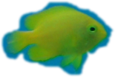
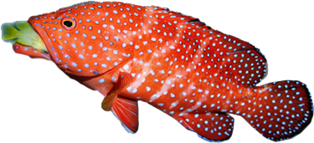

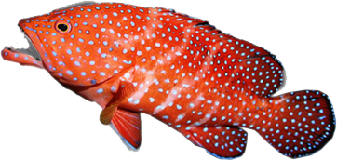
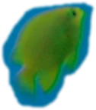
Using smell to inform behaviour
Alarms cue + Predator odour/sight = Danger
Associative learning
Notes:
Damage released chemicals and simple learning mechanism
When a predator comes into the vicinity of some potential little fish, the fishes will respond even if they don’t know the predator by moving away and becoming more vigilant because the fish is larger than they are.
However, when the cod goes and captures out lemon damsel it triggers a hard-wired fright reaction.
Fish that are damaged release a chemical that when smelt by their shoal-mates causes a fright response.
As the smell drifts with the current, it causes a fright reaction in the others of the same species in the area.
All marine animals have a characteristic smell, and predators are particularly smelly. When the predator swims into the picture, he’s followed by a olfactory halo, and this smell gets mixed in with the damaged-released alarm chemicals to tag the predator as a threat (it’s called Associative Learning).
Active chemical even still active in faeces!
Learn from eachother by social learning!

Slide 6
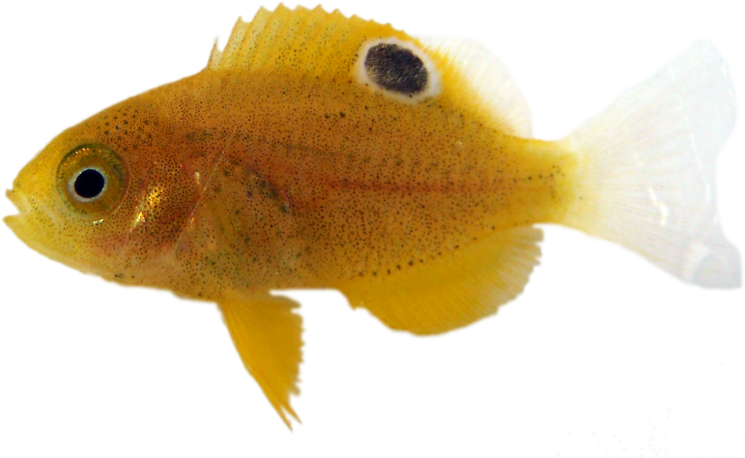
Feeding history affects risk assessment
Arrive with wide range of feeding histories and body condition
Attribute | Coefficient of Variation (%)
Size | 3.1
Weight | 14.3
Fulton’s K (bulk) | 10.5
Lipids | 17.4
Feeding rate | 57.9
Pomacentrus amboinensis
Motivation to take risk will differ and interact with knowledge of who to avoid
Notes:
Avoiding predators is not all the little fish has to worry about; one of its main motivations at this life stage is to eat a great deal and grow fast.
The magnitude of the anti-predator behaviour elicited by a threat is dependent on the feeding history of the individual. Hungry fish, or fish in poor body condition, take more risks to attain their next meal compared individuals that have fed.

Slide 7
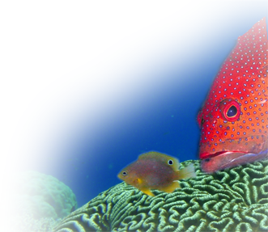
Aim
Determine how feeding history influences the relative importance of olfactory and visual sensory modes of learning to risk assessment
Examine how the experience gained through these sensory modes influences behaviour and survival in the field

Slide 8
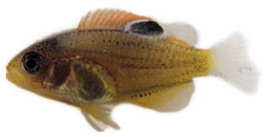
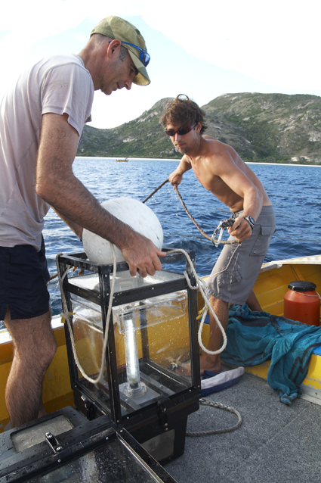
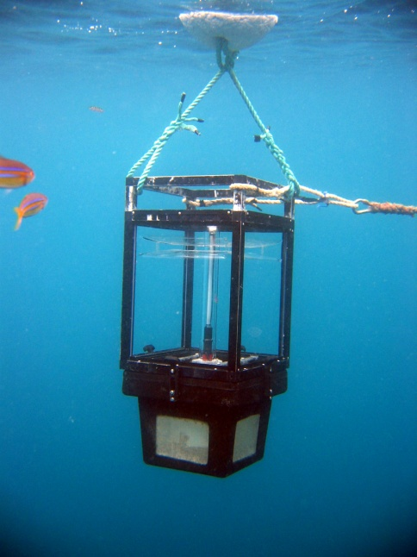
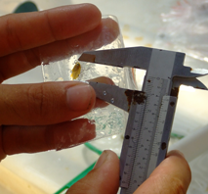
Methods
COLLECTION
Pomacentrus wardi

Slide 9
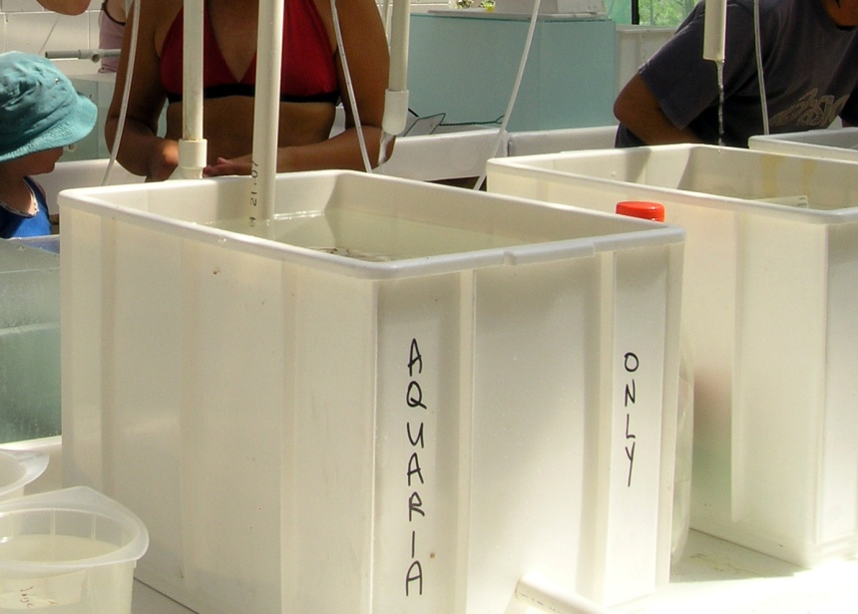
Methods
COLLECTION
PRE-CONDITIONING
Food availability
WELL FED
Fed ad libitum
POORLY FED
Fed 1/8 ad libitum
Notes:
Fed for 6-8d

Slide 10
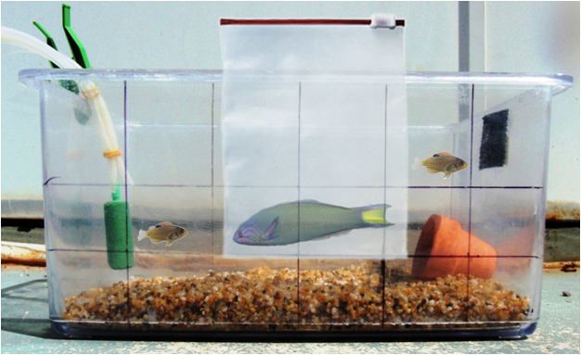

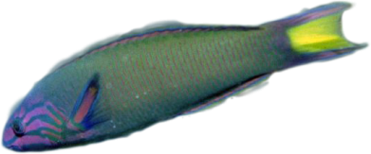
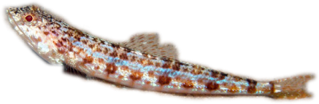
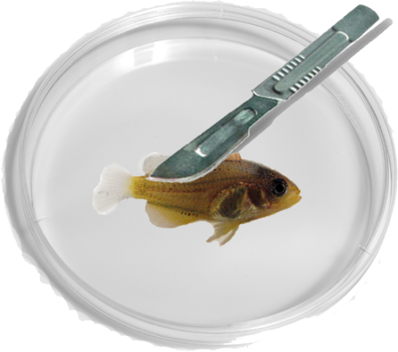

Methods
PRE-CONDITIONING
Food availability
CONDITIONING
Predatory experience
COLLECTION
VISION
 | Yes | No
Yes
No
SMELL
+ Predator
odour

Slide 11
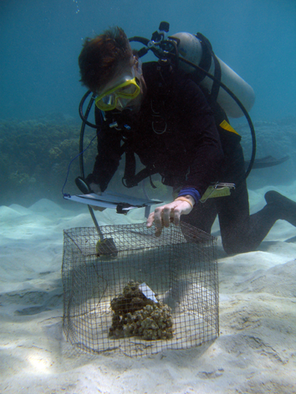
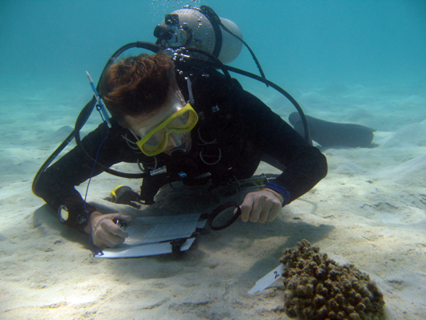
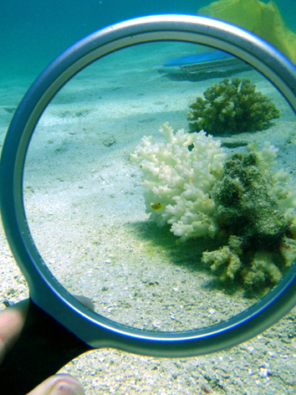
Methods
FIELD OBS & SURVIVAL
PRE-CONDITIONING
Food availability
CONDITIONING
Predatory experience
COLLECTION

Slide 12
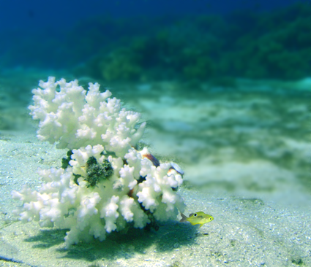
Methods
FIELD OBS & SURVIVAL
PRE-CONDITIONING
Food availability
CONDITIONING
Predatory experience
COLLECTION
Total distance moved
3 minute behavioural assessment
Total distance moved
Max distance ventured
Boldness – scale 0 – 3
Survival monitored 3 days
Max distance ventured

Slide 13
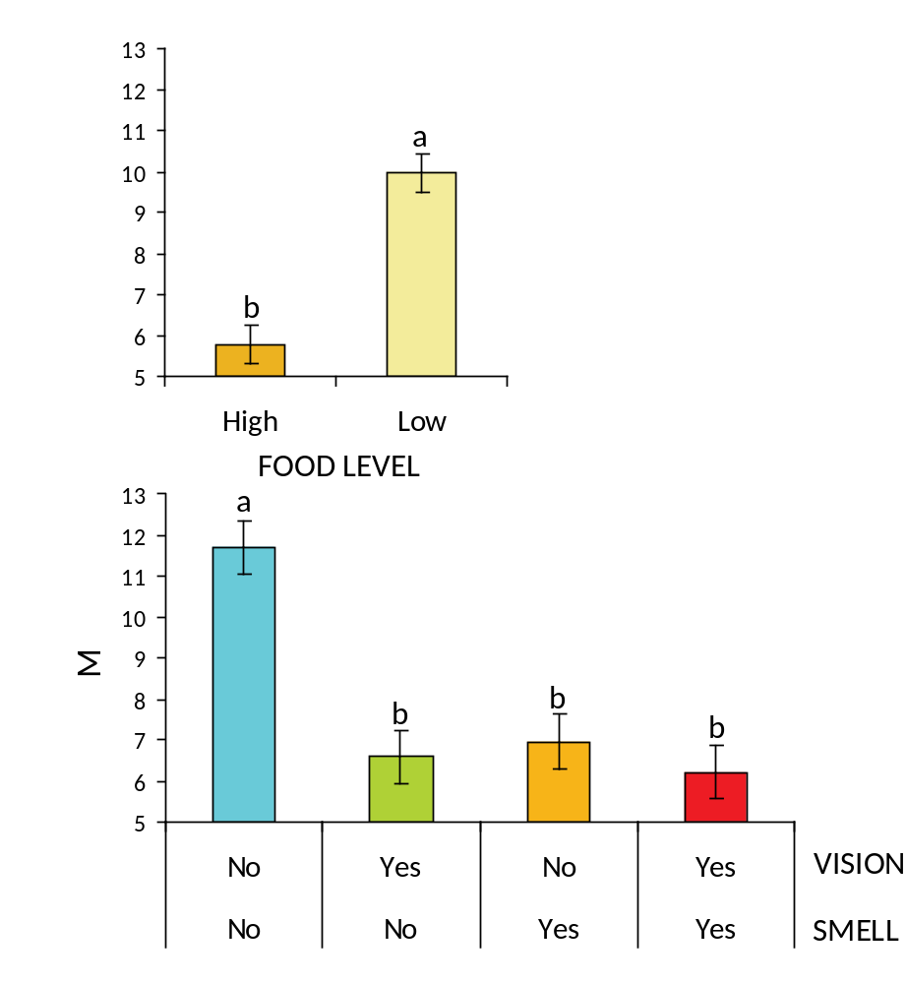
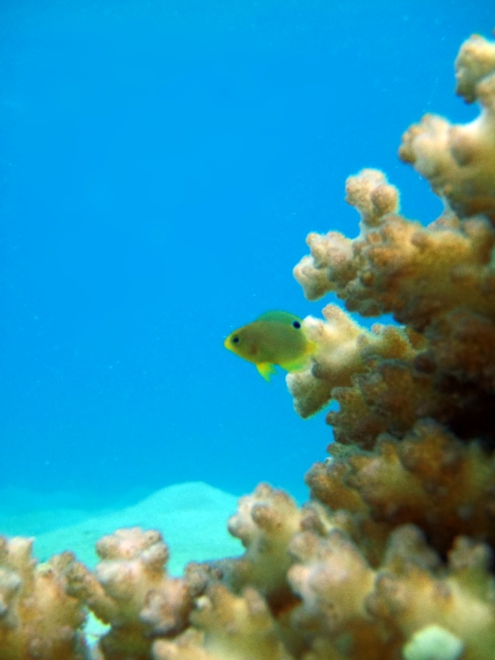
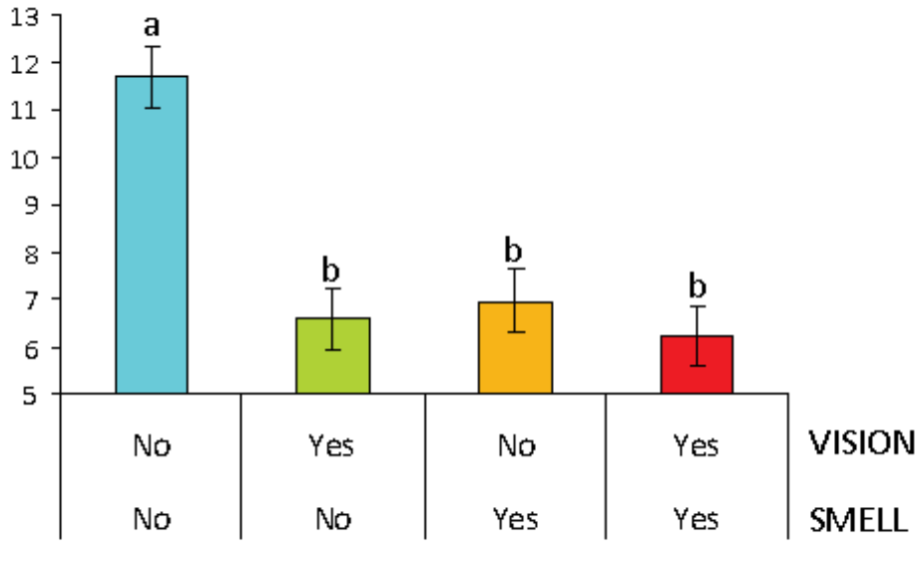
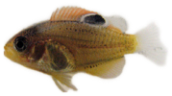
Results
Low condition fish took more risks
(cm)
Predator-experienced fish took fewer risks
Boldness
Total distance moved
No experience
Pre-exposure to predator
PREDATOR EXPERIENCE TYPE

Slide 14
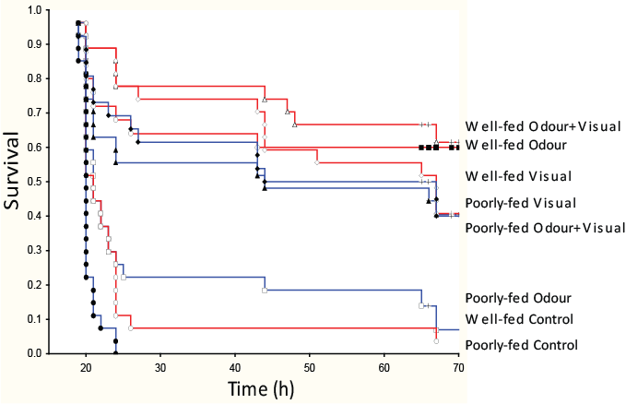
Experience affects survival
Visual + Olfactory experience increased survival 8x !!
Lönnstedt et al. (2012) Proc B
Notes:
Olfactory cues forewarn fish of potential danger and this reaction can be moderated by visual information, which acts as a more direct indication of impending threat.
Experience with a predator (regardless of the cue) rather than feeding history that dominated the differences in survival among groups, suggesting that mortality is not simply explained by behavioural vulnerability alone.

Slide 15
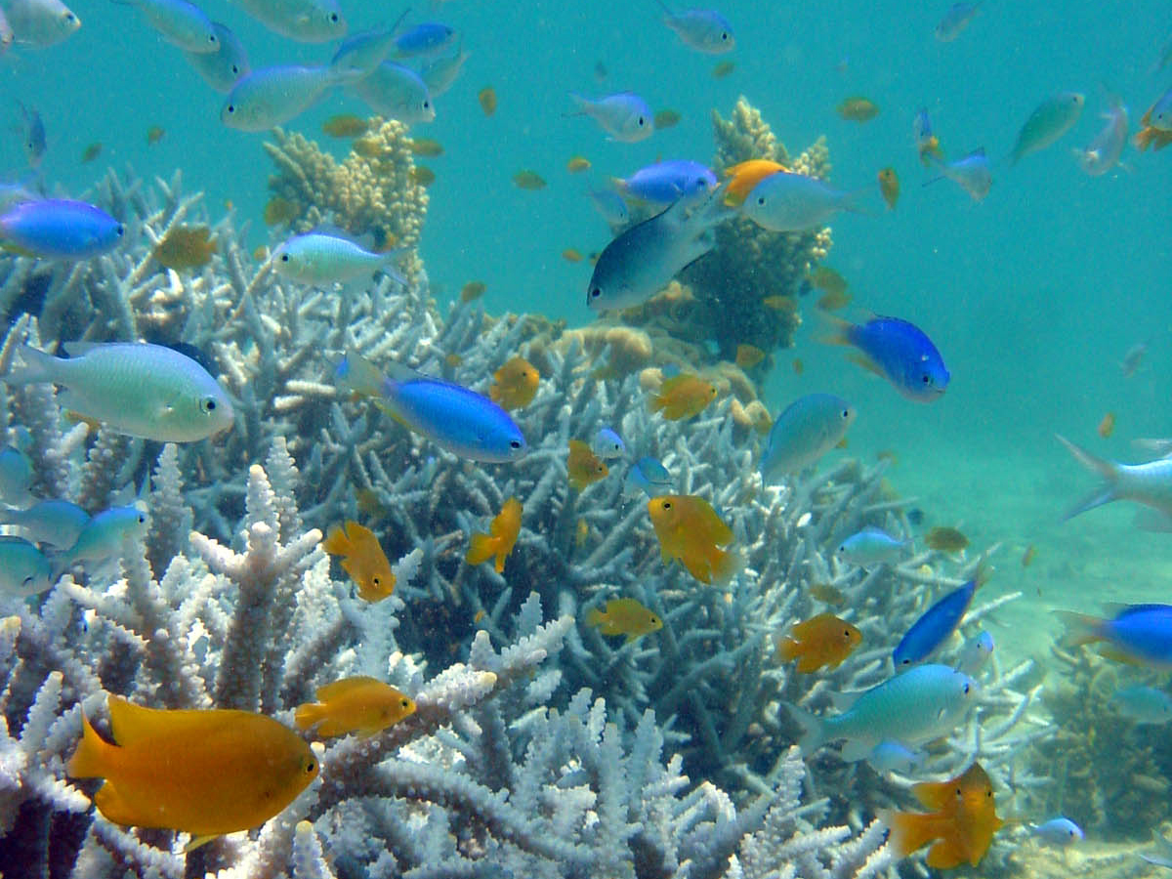
So, fishes quickly learn through experience
Notes:
But fishes live in communities that can contain hundreds of fish species. So there are tell-tail smells associated with all those species in the water that they pass through their gills! It can tell them not only who is around, but what reproductive state they are in, how large the individual that produced the smell was, whether it was in good or poor body condition.
So, how can they avoid labelling the wrong species as a threat? Why don’t they live in constant fear?

Slide 16
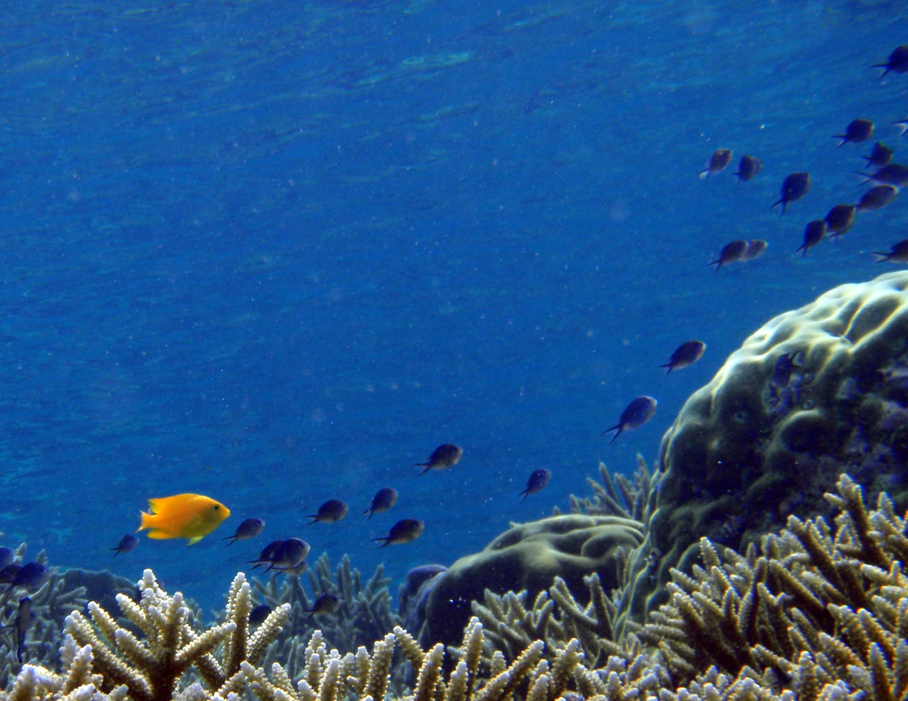
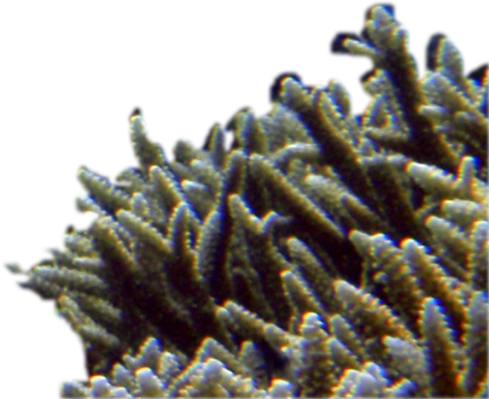

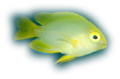
Marine fishes have sophisticated learning mechanism...
Diet cues – expands opportunity for associative learning
          (e.g. Manassa & McCormick 2012a)
Generalisation – generalise responses to predators within same genus (e.g. Mitchell et al. 2012 a,b)
Social learning and public knowledge
  (e.g. Manassa & McCormick 2012b)
Notes:
The window of opportunity for learning the identity of predators is expanded in a number of ways.
The all important alarm cues from the prey appear to be able still be active even after passing through the gut of a predator; this means it greatly extends the time period for learning the identity of predators
Moreover, we have found that prey generalise the learned antipredator response to all fishes within a genus – e.g. They learn a rock cod is a danger and they will generalise the threat to all rock cods.
They can also use public information about who their neighbours are afraid to inform their risk assessment.
This all means that they have a remarkably sophisticated means to learning the identity of predators that is being constantly modified and updated.
This study underscores how critically important this learning process is to the survival of individuals generally, but particularly at life history transitions.

Slide 17
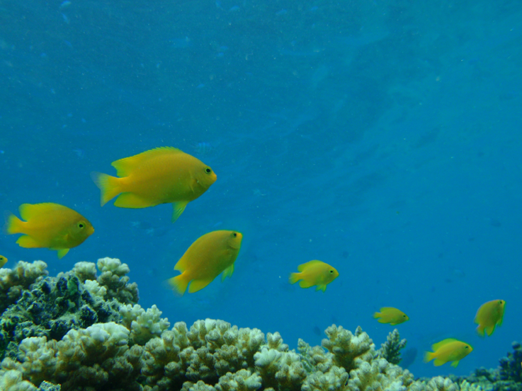


Questions?
Lönnstedt OM, McCormick MI, Meekan MG, Ferrari MCO, Chivers DP (2012) Learn and live: the role of predator experience in influencing prey behaviour and survival. Proceedings of the Royal Society London B 279, 2091-2098
doi: 10.1098/rspb.2011.2516
Maud Ferrari
Doug Chivers
Mark Meekan

